Slide 1
The Great Web
An alternative vision for freedom from digital feudalism
Simanovsky Sergey

Slide 2
Got web 3.0?
The development of what once upon a time was just a mere search via a centralized server that connected a network of peers, to highly efficient, decentralized networks and on-line storage facilities, with motivated nodes, that are cooperating with each other in a coordinated manner with the help of code.
Their direct (no third party involved) coordination and cooperation between each other, a direct and obvious motivation of the user and the node, the coordination of actions with the help of smart contracts and the safe routing of packets and data, etc.

Slide 3
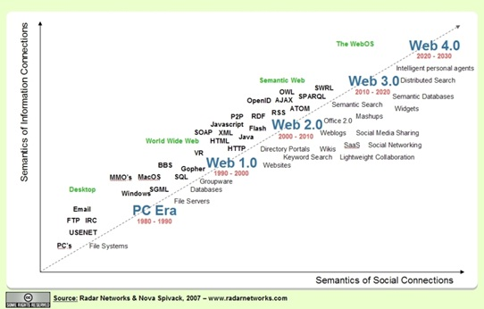
The progress of semantics

Slide 4
That’s not normal...
23% of the internet is free (Freedom house)
47% of world population have some social media blocked (Internet trends)
42% of world population have internet cuts due to political reasons (Internet trends)
Russia, China, USA, Germany, Kazakhstan, New Zealand, Australia, UK, Iran… and many more countries have some kind of internet restriction laws

Slide 5
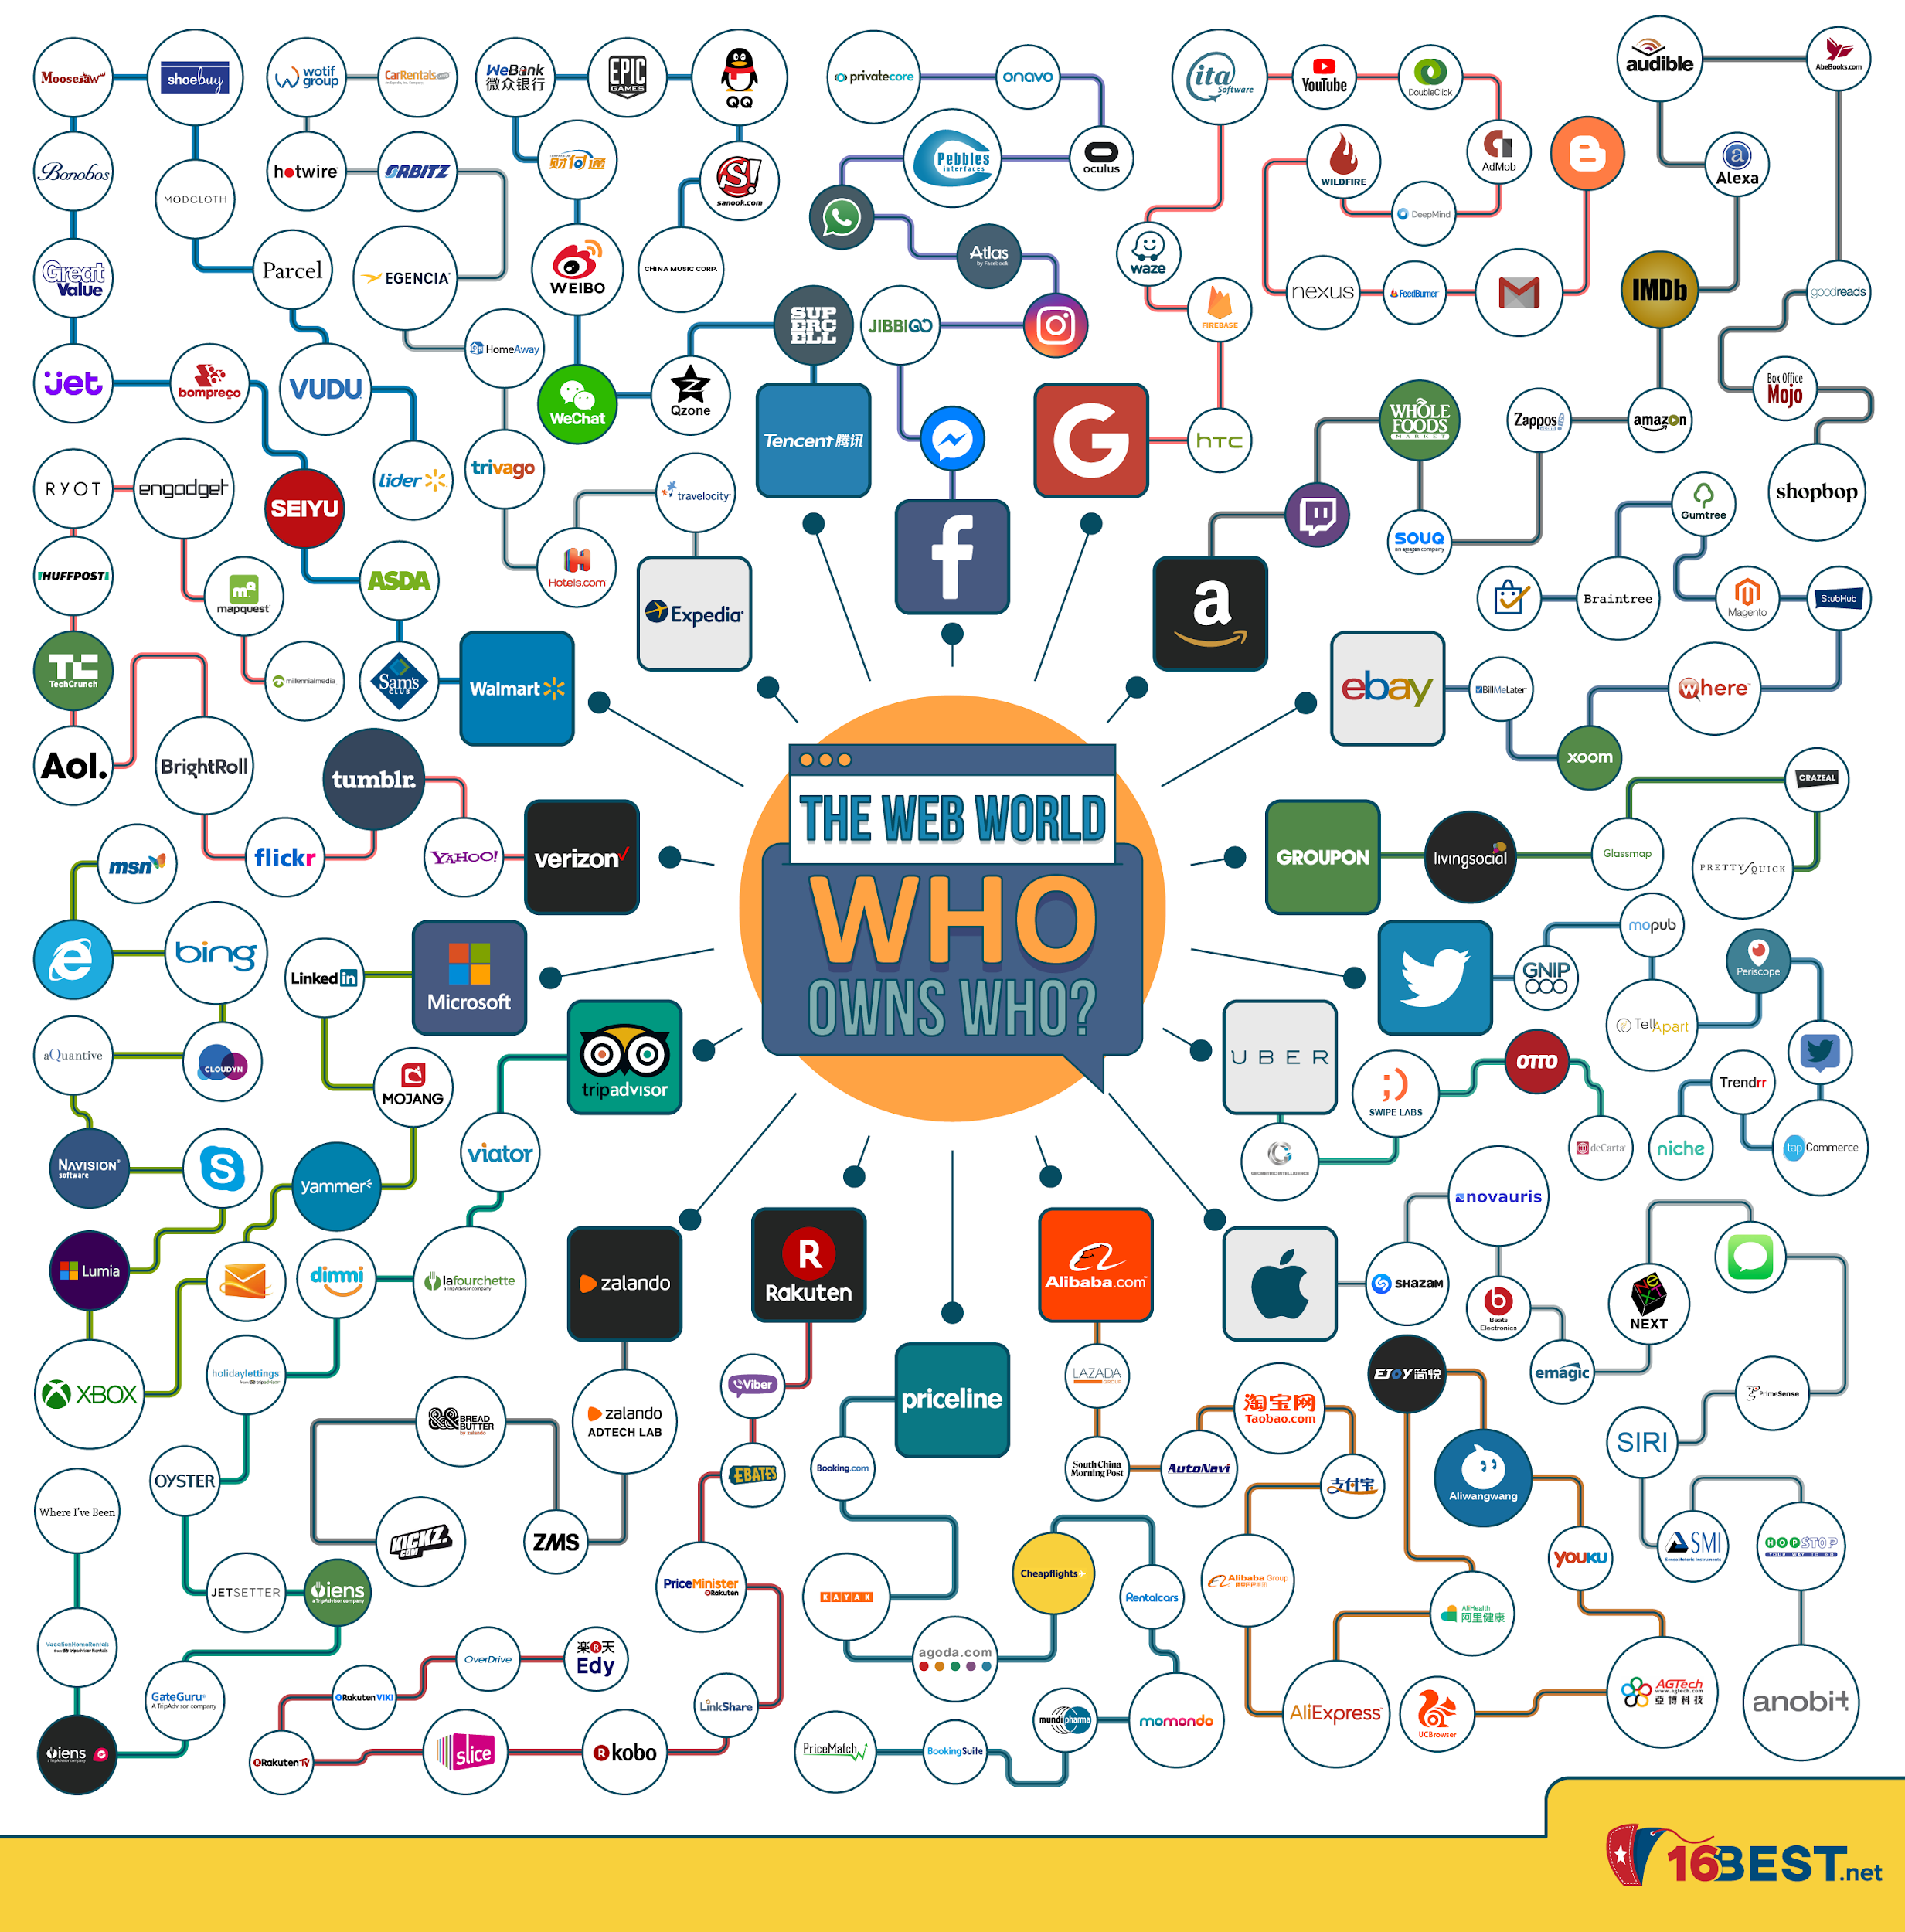
Who owns the int.. you?

Slide 6
Dante's worst nightmare
Centralized top level domains
No interest of solving security
Data reselling
Few beneficiaries
Uncontrolled data loss
HTTP - DNS - URL

Slide 7
That’s not normal...
Name, sex, date of birth, profession, education, interests, preferences, what makes you angry, what makes you happy, when you watch movies, what you like, your heart beat rate, your location, your phone book, your texts and messages, your work and home address, your day schedule, where you rest, what you search for, what websites you visit, what you did in the past days \ months \ years, what you have in your apartment, where and what food you buy, what you buy in general, what you hate, who you talk to and when, who are your relatives and what do they do, your psychological profile, your voice, your friends, what you see before you, what makes you tick, your “secret” searches...

Slide 8
The Great Web
Offline browsing
Local data cashing / trusted storage
Local servers
Reputation and efficiency
Token Curated Registries
Cyber registries
Miners and service providers
IPFS
Indexation and Ranking
Decentralization
Consensus mechanisms

Slide 9
Cyber… don’t google
IPFS hashes
Cyberlinks =! Hyperlinks
Distributed Knowledge graphs
Relevance machine
Bandwidth
cyber~Rank
Consensus
Computation and resources
Subculture
No blackbox intermediaries
Sybil resistance
Why search / linking are important

Slide 10
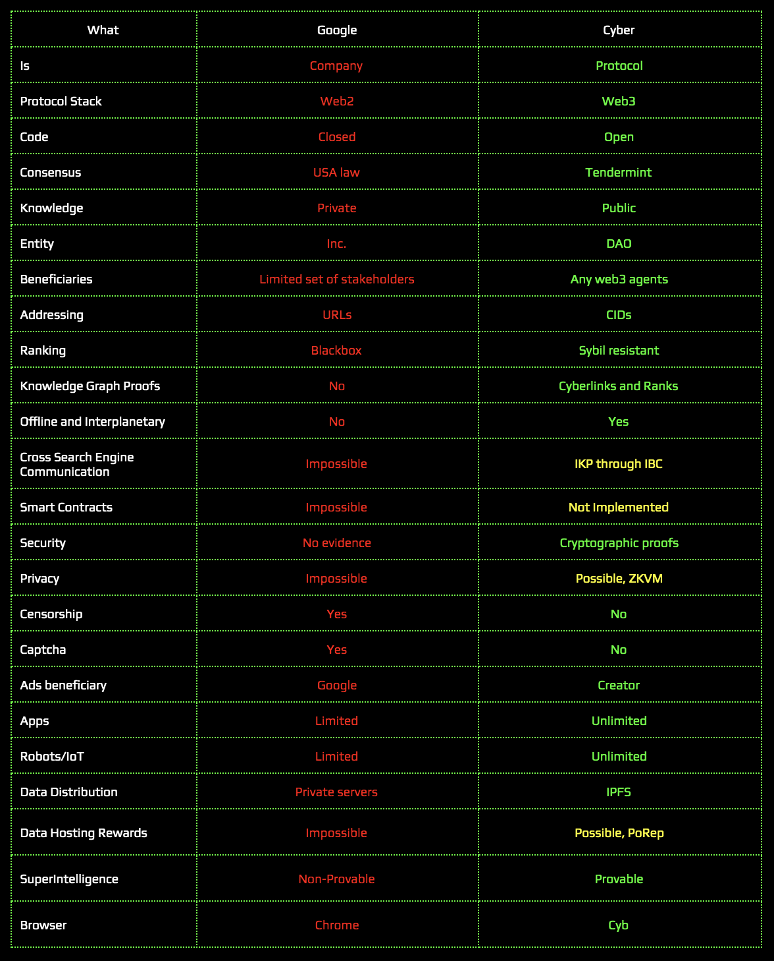
Change the basics first...

Slide 11
QUESTIONS...
https://github.com/cybercongress

